Slide 1

Risk management in the Insurance Industry
Tusarkanta Kar
Final Presentation

Slide 2

Agenda
Introduction/Background
Literature Review
Problem Statement
Methodology
Results & Discussion
Conclusion and Future works
Research Reflection

Slide 3

Introduction
Reinsurance is a mechanism used by insurance companies to transfer a portion of their risk to another insurer, known as the reinsurer. It is a contractual arrangement where the reinsurer agrees to indemnify the insurer for losses incurred on the policies it has underwritten. The primary purpose of reinsurance is to help insurance companies manage their exposure to risks and protect their financial stability.

Slide 4

Literature Review
Risk management in the insurance industry is a critical area of study due to its significant implications for both insurers and policyholders. Various scholars have explored this subject, emphasizing the importance of effectively assessing and mitigating risks in the insurance sector. I have prepared this final thesis under the guidance of Mr. Rituparna Dutta who is my thesis supervisor.

Slide 5
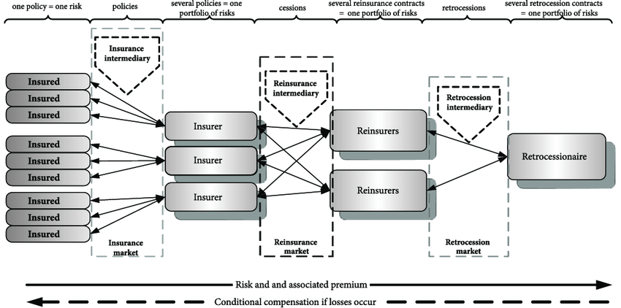
Problem Statement

Slide 6
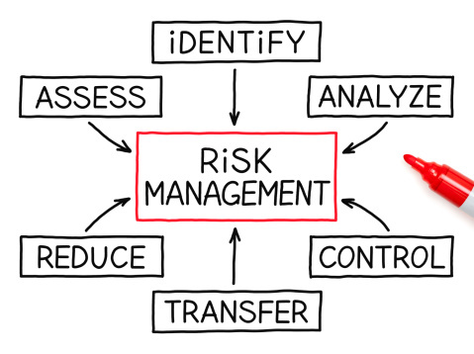
Problem Statement

Slide 7
Methodology
Stochastic Modelling and Probability Theory
Actuarial Models
Value at risks
Data Preparation
Portfolio Identification
Time Horizon Selection
Tail VaR
Interpretation and Decision-Making:
Validation and Monitoring

Slide 8
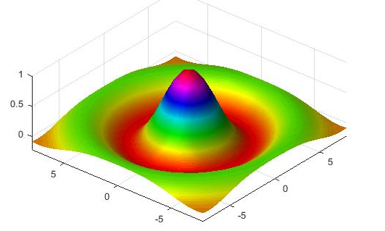
Result and discussion

Slide 9
Result and discussion
1. High Risk (Red Zone): Risks falling in this zone have both a high likelihood and a high impact. These risks are considered critical and require immediate attention and mitigation strategies.
2. Medium Risk (Yellow Zone): Risks in this zone have either a moderate likelihood and high impact, or high likelihood and moderate impact. These risks are significant and should be closely monitored and managed to prevent them from escalating.
3. Low Risk (Green Zone): Risks in this zone have either a low likelihood and high impact, or high likelihood and low impact. While these risks may not require immediate action, they should still be monitored and managed to prevent any potential negative consequences.

Slide 10
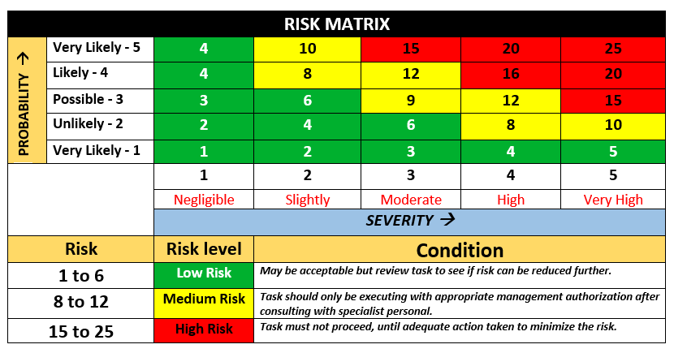
Result and discussion

Slide 11
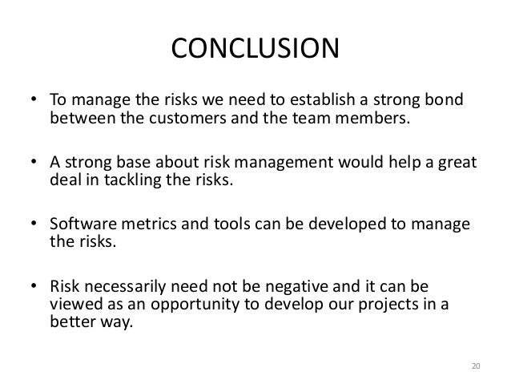

Conclusion and Future works

Slide 12
Research Reflection
One should responsible of financial loss associated with the risk. There are various types of insurance policies available, including property insurance, liability insurance, health insurance, life insurance, and disability insurance. Effective risk management and insurance can help to reduce financial losses, protect assets, and ensure financial stability.

Slide 13


Thank you
Tusarkanta Kar
ulptkar@ljmu.ac.uk
Presentation Link:
https://drive.google.com/file/d/1WoX-Uk8BH4cpalvRSqwZKcv2A6W5XIey/view?usp=sharing

